Slide 1
Status Consumption under extreme inequalities
Department of Economics
a.srivastava@pgr.reading.ac.uk

Slide 2
Conspicuous or status-related Consumption
The tendency of consumers to indicate status by using goods of a higher quality or in higher quantity than what might be considered necessary

Slide 3
Testing for status consumption in developing countries
For
Regardless of poverty levels, status competitions are universal
There is a reference level for all consumer choice (poorer countries have a lower reference level)
Against
Most consumers struggle to meet basic needs. So status is inseparable from fulfilling basic needs
The income differences are wide, starkly visible for there to be any use of status consumption

Slide 4
Why do we want status goods?
A few perspectives:
Veblen : Signaling is inherent in all consumption
Hirsch: Post-war commercialisation and advertising has removed the difference between necessities and quality (physical and social scarcity)
Baudrillard : The “active manipulation of signs”– the mechanism to insert oneself within the consumer society (and working to differentiate oneself from others) is itself a form of labour
Frank: The consumer improves self-image and felicity through status competitions (subject to their reference point)

Slide 5
Does consumption influence status?
Before we talk about a model for status consumption, we ask first if status – viewed as a social position based on wealth/occupation –determines consumption or instead if consumption itself predominantly drives status
This is an empirical assessment and requires us to define what status and status goods mean in a given socio-cultural context
In order to compare status consumption across economies, we take a general view and consider status as both wealth and consumption
Consumption is in turn a combination of durable consumption and non-durable consumption in excess of needs

Slide 6
Status and Consumption
Two key assumptions support our definitions and model:
A1. Rational Benefit from status consumption - There is a rational benefit to be had from status consumption (otherwise consumers would stay away from it in the long-run).
A2. Longevity of Durable goods - Status-related consumption that is not considered “wealth” (i.e. most of non-durable status-related consumption) cannot be inherited (bequeathed) but all else would be.

Slide 7
Status and Consumption
A1 (benefit from status consumption) ensures that all consumers –benefit from high non-durable consumption relative to their needs
A2 (durable good longevity) separates the long-term consumption from short-term consumption in the context of differences in consumer wealth levels

Slide 8
Defining Excess Non-Durable Consumption
How do we define needs?
We accept the Doyal-Gough view and consider needs as only a guarantee of health and autonomy. Therefore status is not a basic need.
Defining Excess : Arguing that different households cannot have different basic except for age-composition and cardinality, we argue that
Anything above the cost of needs is of some potential status value to the consumer
Any durable goods purchased are also of some status value
All else are basic needs
Empirical interpretation of needs: We argue that food would carry some status value in societies where food security problems are widespread

Slide 9
Defining: Durable Consumption
Goods that can be transferred over generation as the durable goods relevant for status consumption. These serve as proxy of wealth. All else is non-durable consumption.
The LSMS survey which we rely upon provides assets owned by consumers for all the countries surveyed.

Slide 10
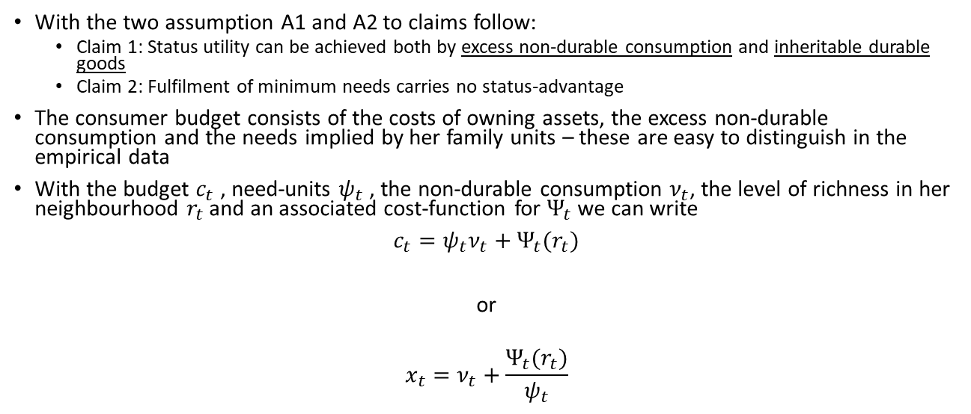
Modelling Status Consumption
With the two assumption A1 and A2 to claims follow:
Claim 1: Status utility can be achieved both by excess non-durable consumption and inheritable durable goods
Claim 2: Fulfilment of minimum needs carries no status-advantage
The consumer budget consists of the costs of owning assets, the excess non-durable consumption and the needs implied by her family units – these are easy to distinguish in the empirical data
With the budget $c_{t}$ , need-units $ψ_{t}$ , the non-durable consumption $ν_{t}$, the level of richness in her neighbourhood $r_{t}$ and an associated cost-function for $Ψ_{t}$ we can write
$c_{t}=ψ_{t}ν_{t}+Ψ_{t}(r_{t})$
or
$$x_{t}=ν_{t}+\frac{Ψ_{t}(r_{t})}{ψ_{t}}$$

Slide 11
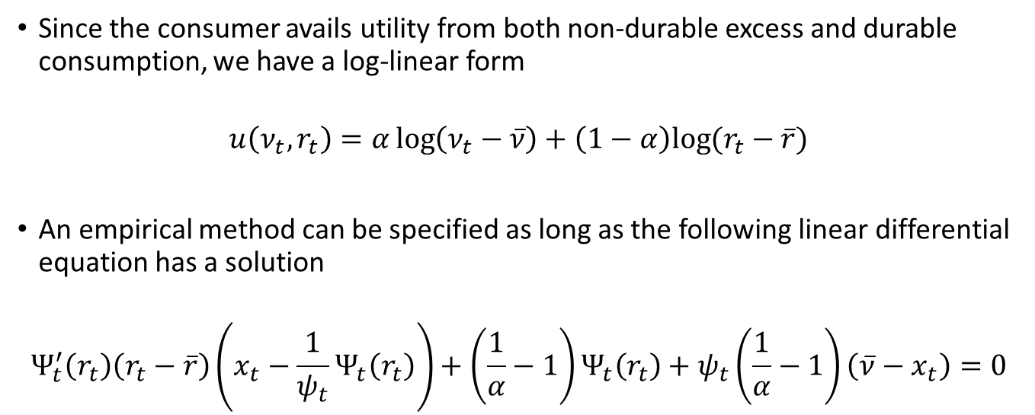
A model for Status Demand (contd.)
Since the consumer avails utility from both non-durable excess and durable consumption, we have a log-linear form
$$u\left(ν_{t},r_{t}\right)=α\log\left(ν_{t}−\overline{ν}\right)+\left(1−α\right)log⁡(r_{t}−\overline{r})$$
An empirical method can be specified as long as the following linear differential equation has a solution
$$Ψ_{t}^{′}\left(r_{t}\right)\left(r_{t}−\overline{r}\right)\left(x_{t}−\frac{1}{ψ_{t}}Ψ_{t}\left(r_{t}\right)\right)+\left(\frac{1}{α}−1\right)Ψ_{t}\left(r_{t}\right)+ψ_{t}\left(\frac{1}{α}−1\right)\left(\overline{ν}−x_{t}\right)=0$$

Slide 12
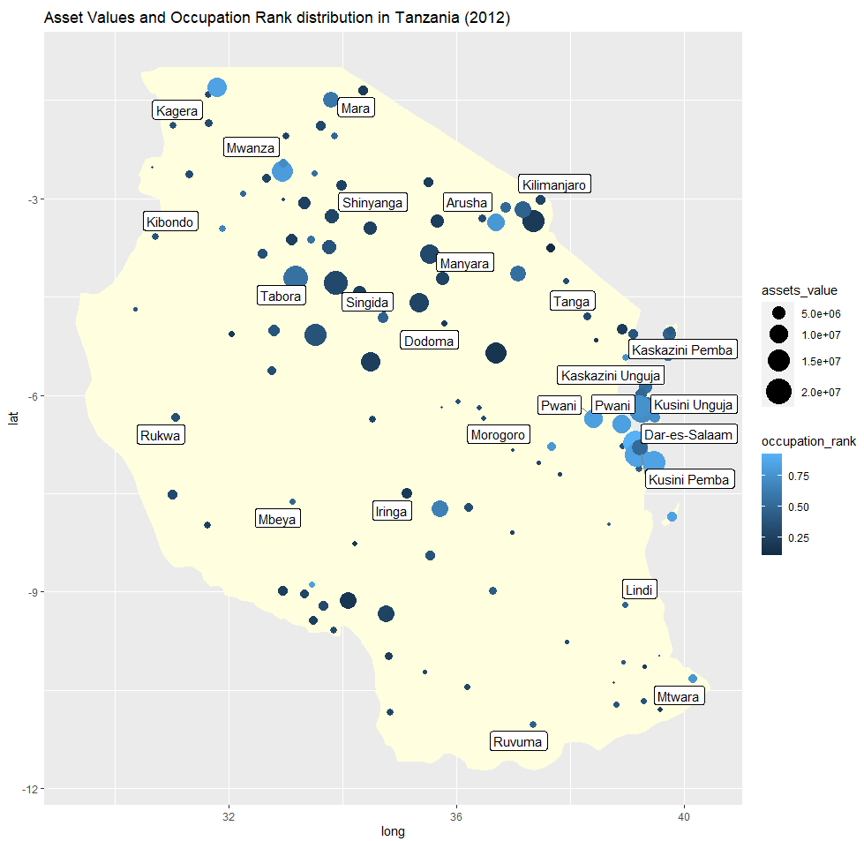
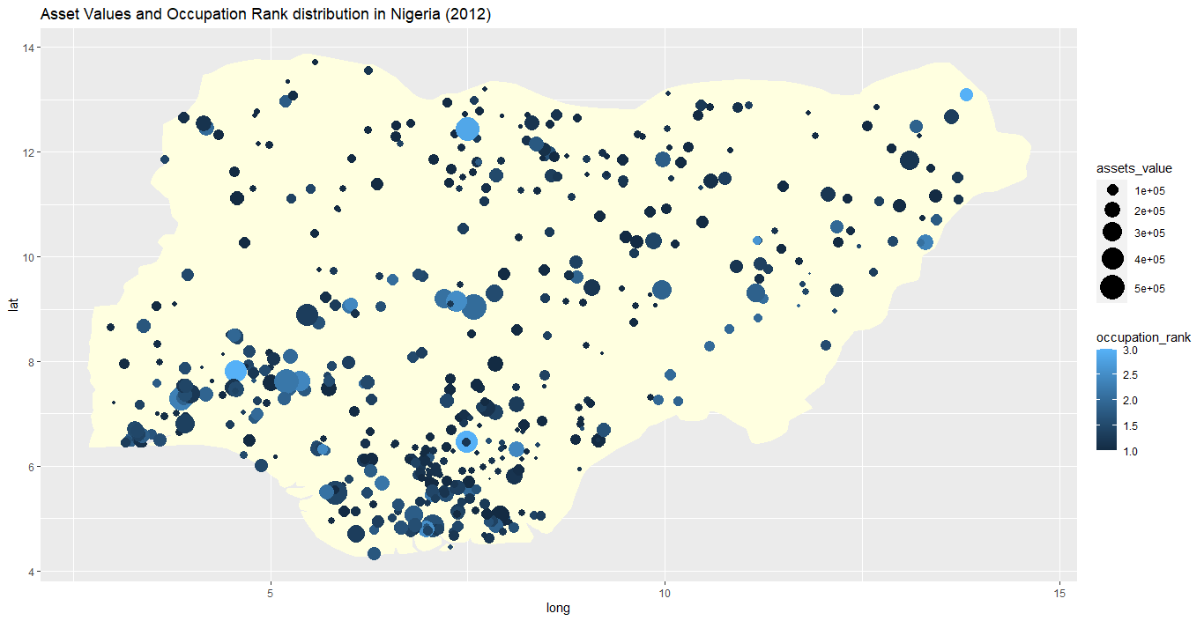
Comparing economies – the role of occupation vs region
Using income data, we standardise occupations into occupation ranks for comparison across economies
Occupational and Asset differences are shown in the following chart. A more even distribution of assets and occupation-levels seems evident in Nigeria.

Slide 13
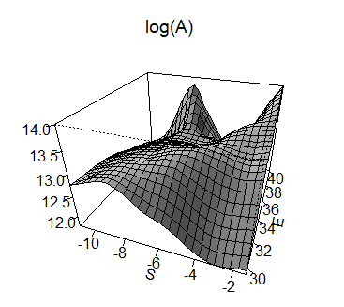
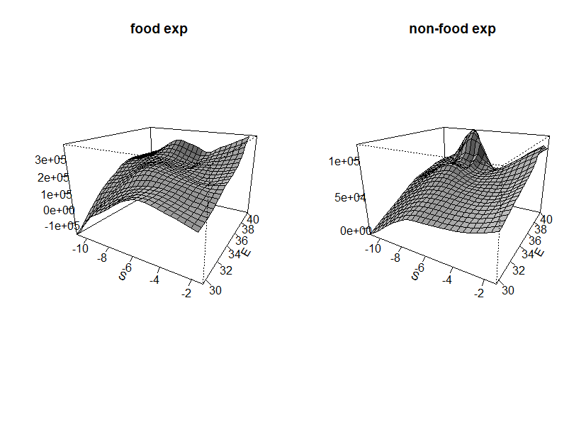
Tanzania – A non parametric view
Non-food expenditures are much higher
in the east of the country
Vast differences in asset ownership across the country

Slide 14
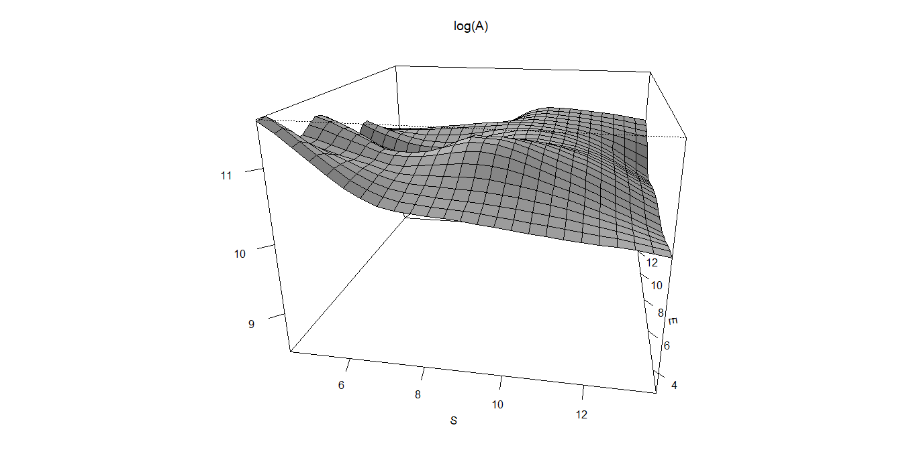
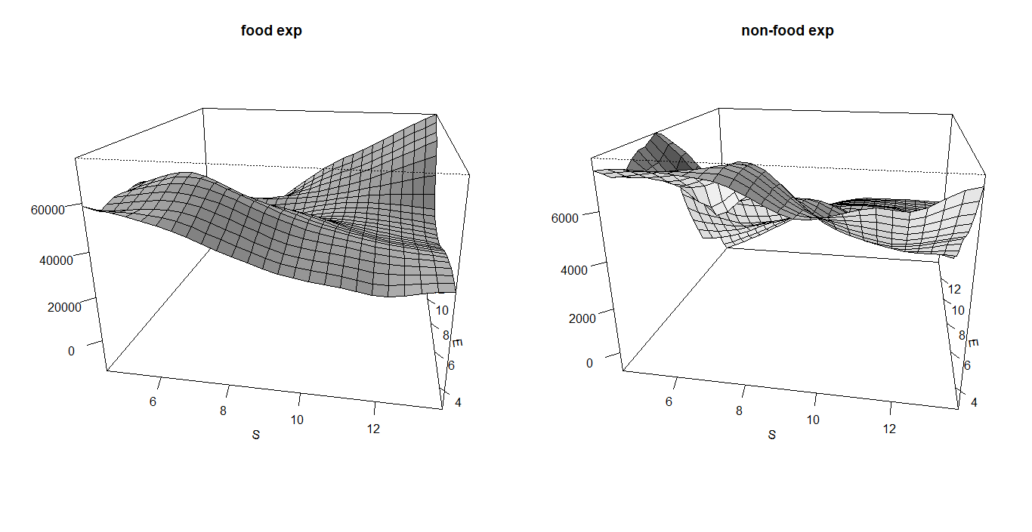
Nigeria – A non parametric view
The asset differences are relatively flat
The north-east of the country has higher food expenditure but the coastal south-west has higher non-food expenditure

Slide 15
Interpreting non-parametric and descriptive data
Tanzania
There are vast differences in asset ownership
Occupational differences across regions are high
The south and east of Tanzania are too far apart in assets and have incomparable amenities. This is less so in the central parts
The subjective well being data also does not align with the asset distribution.
Nigeria
The asset differences are fewer
Occupational and educational differences are more uniform across regions

Slide 16
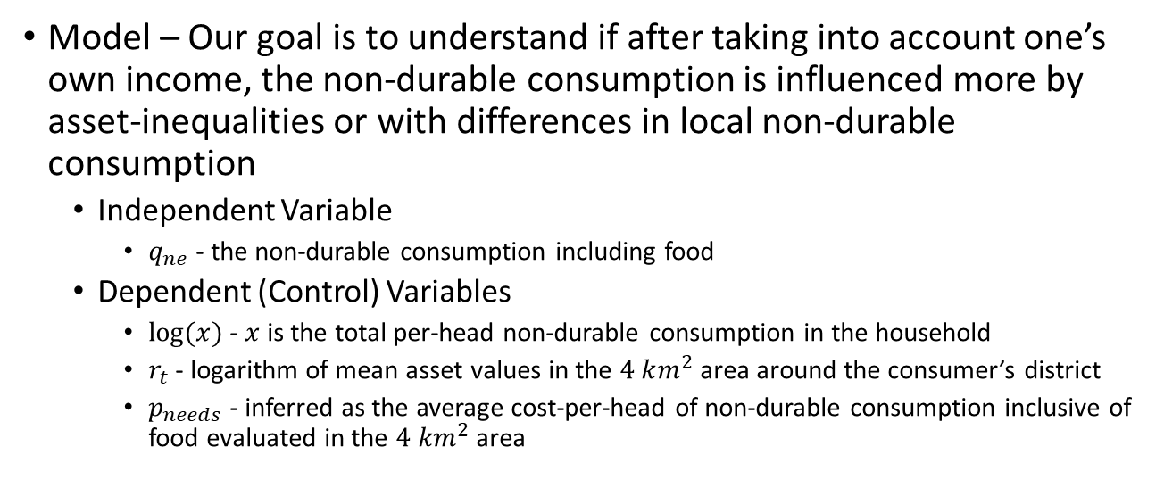
Parametric Analysis
Model – Our goal is to understand if after taking into account one’s own income, the non-durable consumption is influenced more by asset-inequalities or with differences in local non-durable consumption
Independent Variable
$q_{ne}$ - the non-durable consumption including food
Dependent (Control) Variables
$log⁡(x)$ - $x$ is the total per-head non-durable consumption in the household
$r_{t}$ - logarithm of mean asset values in the $4 km^{2}$ area around the consumer’s district
$p_{needs}$ - inferred as the average cost-per-head of non-durable consumption inclusive of food evaluated in the $4 km^{2}$ area
Notes:
The idea is that the consumer spending on non-durable consumption inclusive of food is influence by her total expenditure (depending on her own income) and the overall factors.

Slide 17
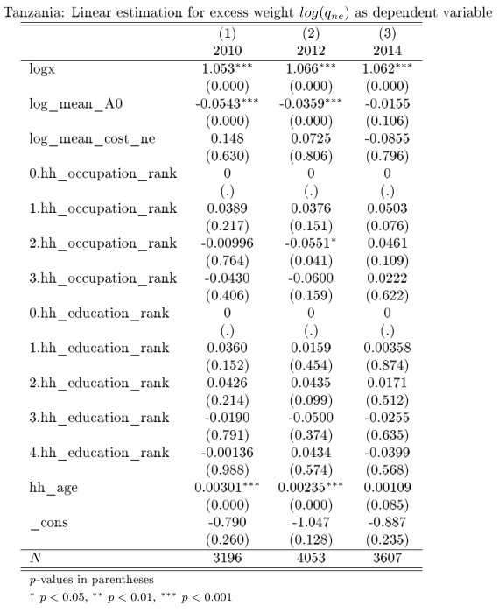
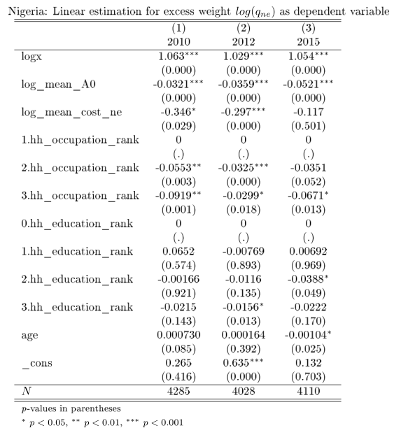

Cross-Sectional View
Notes:
The cross-sectional results say that after taking into account the effects of total budget, those with higher assets have less non-durable consumption relative to the costs of where they live. In other words, other than their own total richness, a lower q_ne is more often due to the area being rich. When you’re in a rich area you’re consuming less non-durable consumption not more. In Nigeria too, this is likely but the effect of higher cost of ne is much stronger. When you’re in an area where prices are also high, your nde is lower. In fact the economic significance is higher. Being in an area with high non-durable consumption average brings down the high nde.

Slide 18
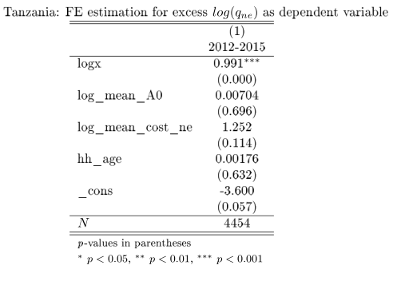
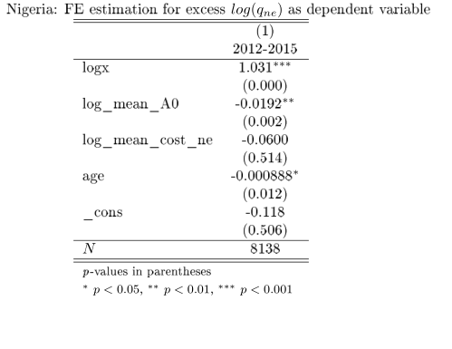


Panel View
Notes:
Observing the same household over 2-3 years, we see that those with high income would have higher nde but those in asset-richer areas would spend much lower in Nigeria. In other words, as consumers become asset-richer in the area, their nde goes down. But in Tanzania, the substitution is between mean-cost-ne and nde.

Slide 19
Observations from the Panel and Cross-Section Analysis
The economic significance of local (neighborhood) expenditure is generally higher (removing logx confirms this)
The role of education as well as occupation for non-durable consumption seems stronger in Nigeria
For the same household, changes in asset-richness seems to drive consumption of non-durable goods – but relatively speaking, the non-durable consumption is Tanzania is more sensitive to average local expenditure
There seems more inertia with asset-boundaries in Nigeria as there is a substitution between asset-richness and non-durable consumption. Once consumers have acquired assets, therefore, their consumption does not change. This is less so in Tanzania.

Slide 20
Key Takeaways
A necessary implication of the model is that consumers with both lower durable consumption and lower relative excess cannot compete with the consumer for whom both are higher
The effect of urban-rural differences dominates the notion of visible consumption

Slide 21
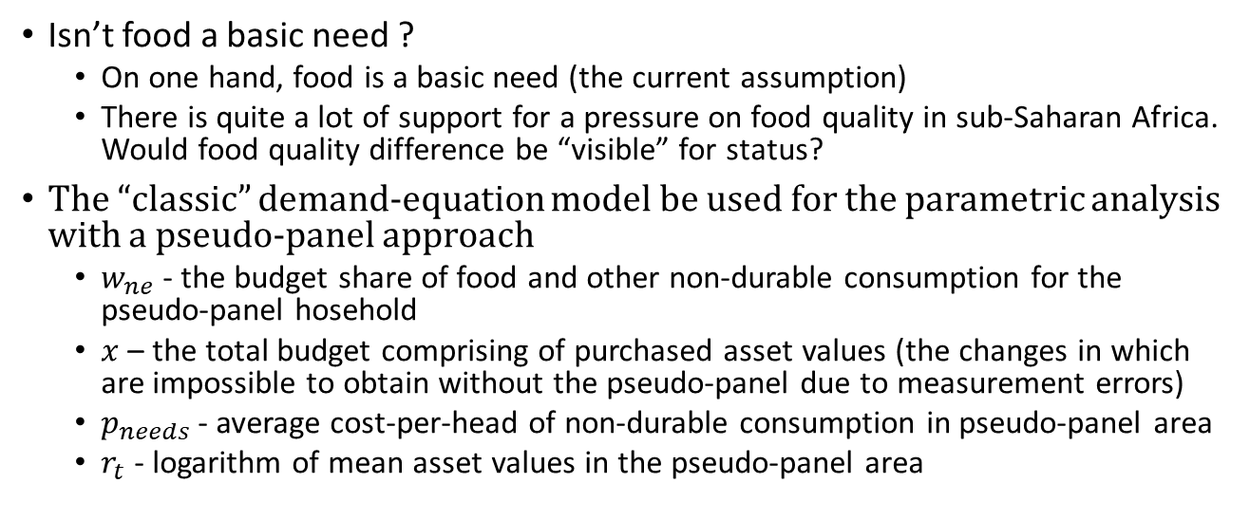
Discussion
Isn’t food a basic need ?
On one hand, food is a basic need (the current assumption)
There is quite a lot of support for a pressure on food quality in sub-Saharan Africa. Would food quality difference be “visible” for status?
The “classic” demand-equation model be used for the parametric analysis with a pseudo-panel approach
$w_{ne}$ - the budget share of food and other non-durable consumption for the pseudo-panel hosehold
$x$ – the total budget comprising of purchased asset values (the changes in which are impossible to obtain without the pseudo-panel due to measurement errors)
$p_{needs}$ - average cost-per-head of non-durable consumption in pseudo-panel area
$r_{t}$ - logarithm of mean asset values in the pseudo-panel area

Slide 22
References
A Deaton, Understanding Consumption, Clarendon Press 1993
N J Ireland, “On limiting the market for status signals,” Journal of Public Economics, 1994
L Doyal and I Gough, A Theory of Human Need, Palgrave London 1991
Robert H Frank, “The Demand for Unobservable and Other Nonpositional Goods”, The American Economic Review, vol. 75(1), pp. 101-116
G Corneo and O Jeanne, “Conspicuous consumption, snobbism and conformism,” Journal of Public Economics, vol. 66, pp. 55–71, 1997

